Slide 1

From Idea to Deployed AI Product
Build · Reproduce · Deploy
"You have an app idea. How do you turn it into something an employer would actually care about?"
AI
SOFTWARE DEVELOPMENT
RESEARCH
CLOUD
PORTFOLIO

Slide 2
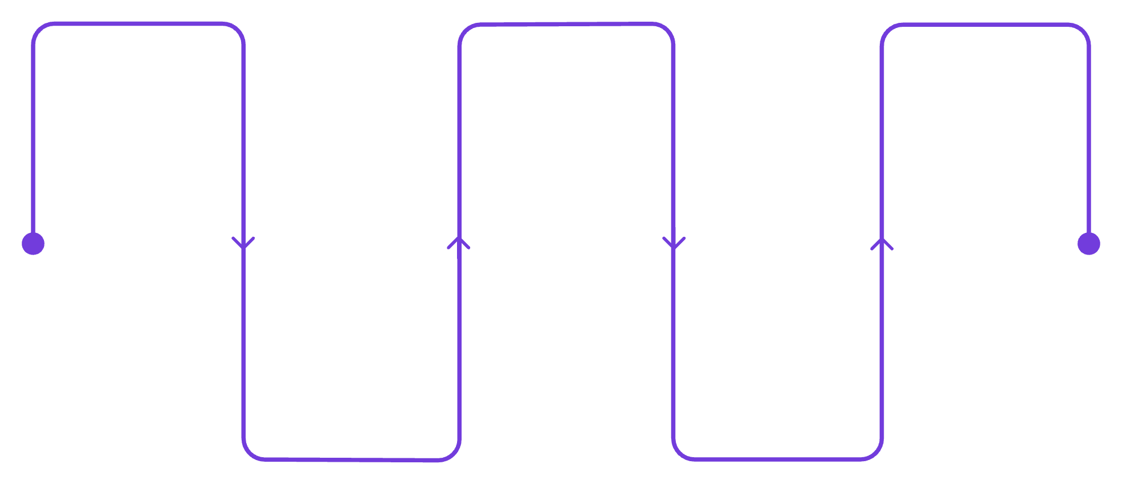
What Happens After You Get an Idea?
Idea
Build
Deploy
Conceptualize with AI prompts
Implement code with AI helpers
Release and monitor with AI
Requirements
Test
Refine specs using AI insights
Validate features via AI tools
Session Roadmap
Audience Question
01
Which step do you think takes the most time?
Build with AI
02
Learn from Research
03
Deploy to Cloud
04
Build Your Portfolio

Slide 3

Same Software Lifecycle. New Teammate.
AI as Your Development Partner
Requirements
Coding
Testing
Write manually → AI identifies gaps & edge cases
Write everything yourself → AI drafts & explains code
Think of cases manually → AI suggests additional cases
Debugging
Deployment
Search errors manually → AI explains possible causes
Configure manually → AI explains infrastructure & CI/CD
Golden Rule: Never use AI-generated code you don't understand. AI accelerates the work — YOU remain responsible for the result.

Slide 4
AI + Developer > AI Alone
What Humans Do
What AI Does
Understand the actual problem
Talk to users
Make technical decisions
Validate AI output
Handle trade-offs
Take responsibility
Generate ideas
Write boilerplate code
Explain code
Generate test cases
Debug errors
Create documentation
Speed up repetitive tasks
The valuable skill is not "knowing how to prompt." The valuable skill is knowing what to ask, what to verify, and why the solution works.

Slide 5


Real Time Scenario
Scenario: Your college wants an app to report campus problems.
Examples
Discuss in 60 Seconds
Possible Ideas
Broken lights
Water leaks
Wi-Fi problems
Classroom issues
Users: Students, faculty, maintenance staff
Feature: Report issue + photo + location + status tracking
AI: Categorize issue, prioritize urgency, summarize complaints
Who are the users?
What is ONE must-have feature?
Where could AI help?
Key insight: AI starts with understanding the problem — not opening ChatGPT.

Slide 6

From Using AI → Reproducing AI Ideas
Don't Just Use AI. Understand It.
1
2
3
Deeper Skill
Better Resume
Differentiation
Implementing a research idea teaches how the technology actually works.
"I implemented a RAG system" is stronger than simply saying "I used ChatGPT."
Most students consume AI tools. Fewer students build and understand AI systems.
You don't need to reproduce an entire research paper. Pick ONE idea and build a small working prototype.

Slide 7
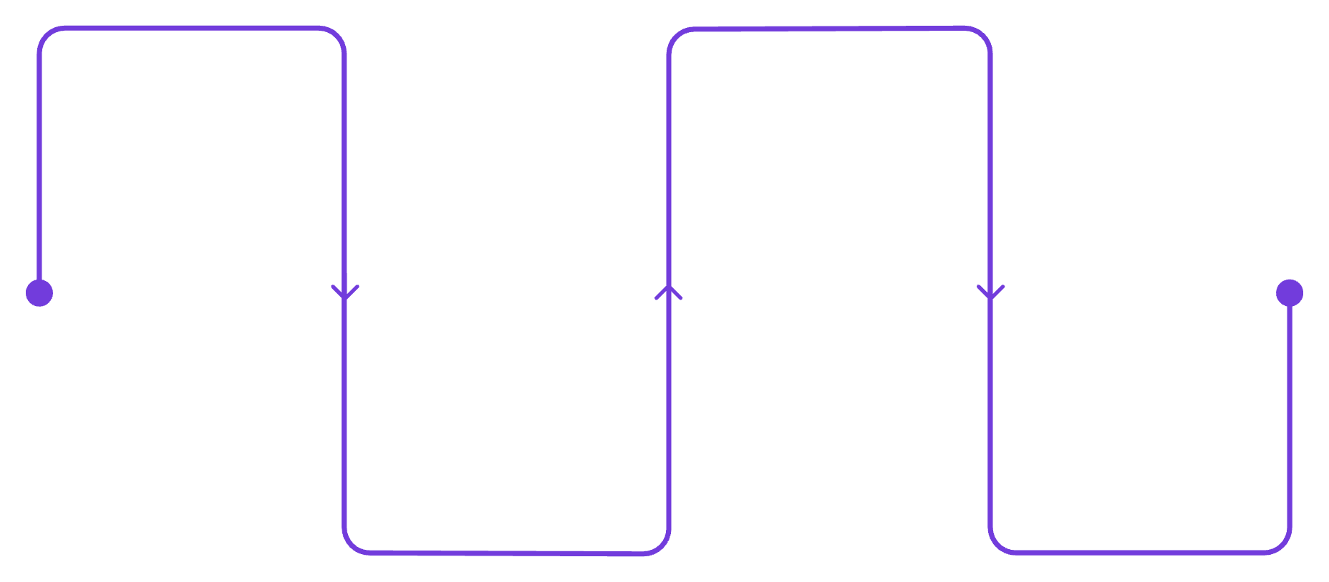

Research Paper → Prototype → Product
Case Study: RAG (Retrieval-Augmented Generation)
The Idea
AI answers questions using external knowledge and documents.
Research Paper
Cloud Deployment
The Prototype
AI answers using external documents
Host services and scale retrieval
PDF Chat Application
Upload PDF → Process → Retrieve relevant content → Generate answer
Code Prototype
Portfolio Project
The Product
PDF Chat App: upload and process PDFs
Case study showcasing RAG solution
Deploy the application using cloud + AI services.
This is how students convert learning into something they can demonstrate in interviews.

Slide 8





Your Project Becomes Real When You Deploy It
Take It From Laptop to Cloud
Simple AWS Architecture
Local Laptop
API Gateway
Receives requests
↓
Cloud Deployment
AWS Lambda
Runs application logic
Amazon Bedrock
↓
Provides AI model capabilities
Real Users
S3 Storage
Stores files and output
Cloud skills + AI skills = stronger industry profile
AWS
LAMBDA
S3
API GATEWAY
BEDROCK
EC2

Slide 9




Design Your Own AI Application
1. WHO?
2. PROBLEM?
Who is your user?
What problem are you solving?
3. AI?
4. CLOUD?
Where exactly will AI help?
How could you deploy it?
Good Project Checklist
Up Next
Real problem
Useful AI
Working prototype
Deployment
2–3 groups will share their ideas.

Slide 10

Don't Just Submit a Project. Build a Portfolio.
Final-Year Project → Industry Project
The Roadmap
The Transformation
Idea
College Project
Industry-Ready Project
"Built a project for submission."
"Identified a problem, designed the system, used AI responsibly, tested it, deployed it, documented it, and can explain every decision."
AI-Assisted Requirements
Portfolio Checklist
Architecture
GitHub repository
README
Development
Architecture diagram
Working demo
Test cases
Cloud deployment
Testing
Short project explanation
Research / Improve
Cloud Deployment
GitHub + Documentation
Live Demo
Resume / Interview

